Slide 1
Front End Engineering-I Project
Team Details:
Vivek bhatt
Vrinda garg
Yash chauhan
Faculty Coordinator:
DR. RATANDEEP ANEJA
:
Chitkara University Institute of Engineering and Technology,
Chitkara University, Punjab

Slide 2
Table of Contents
Introduction
Problem Statement
Technical Details
Key Features
Project Highlights
Bonus Feature(optional)
Conclusion
References/Links used

Slide 3
Introduction
AN AUCTION PLATFORM
Runway Ready is a dynamic auction platform designed to streamline the buying and selling of second-hand items. With a user-friendly interface and a focus on simplicity, Runway Ready offers a convenient and efficient solution for individuals looking to part with their pre-loved possessions or find unique treasures at great prices. Our platform caters to a wide range of products, from fashion and accessories to electronics, collectibles, and more, making it the go-to marketplace for both buyers and sellers.

Slide 4
Problem Statement
Runway Ready addresses the common challenges associated with buying and selling second-hand items in an online marketplace. This platform solves several key problem statements:
1.Uniqueness and Variety: Runway Ready caters to a wide range of products, allowing users to discover unique items that may not be readily available in traditional marketplaces.
2.Cost-Effective Shopping: Buyers can find high-quality second-hand items at competitive prices, helping them save and earn simultaneously.
3.Engaging Auction Experience: Runway Ready brings the excitement of traditional auctions to the online space, creating an engaging, interactive experience for users who enjoy the thrill of bidding.

Slide 5
Technical Details
It an innovative auction platform created as a captivating college project and presentation. Built using HTML, CSS & JS. Runway Ready showcases the power of design and creativity in web development. Our platform is a testament to the potential of these fundamental web technologies, providing a user-friendly and visually engaging space for buyers and sellers to connect. Whether you're a fashion enthusiast, collector, or just someone with an eye for style, Runway Ready is your go-to destination for thrilling auctions and fabulous finds.

Slide 6
Key Features
Runway Ready, developed with HTML, CSS and JavaScript, offers a host of key features:
User-Friendly Design: An intuitive and visually engaging interface.
2.Item Listings: Easy-to-use forms for sellers to list items.
3.Real-Time Bidding: Which helps user to get an engaging bidding experience.

Slide 7
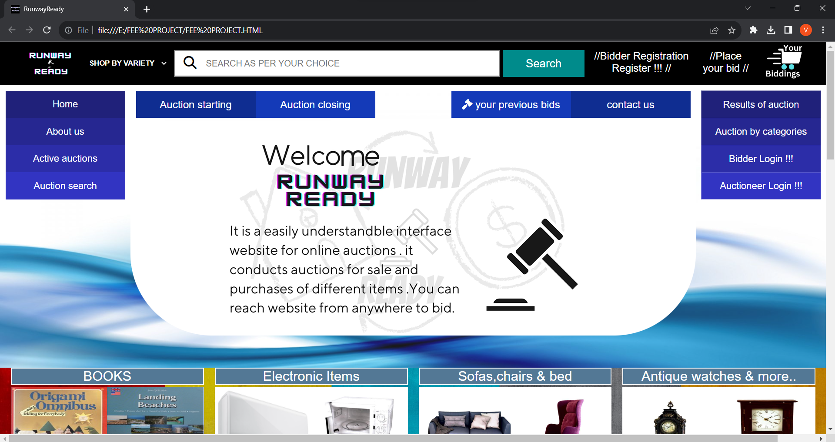
Project Highlights
MAIN PAGE

Slide 8
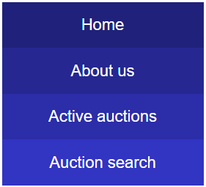
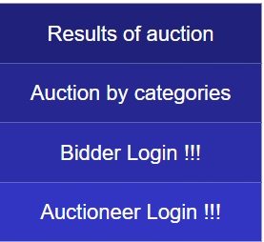
NAV-BARS
MAIN NAV
CENTER NAV
NAV1
NAV2

Slide 9

A VIDEO EMBEDDED IN THE CENTER OF NAV BARS

Slide 10
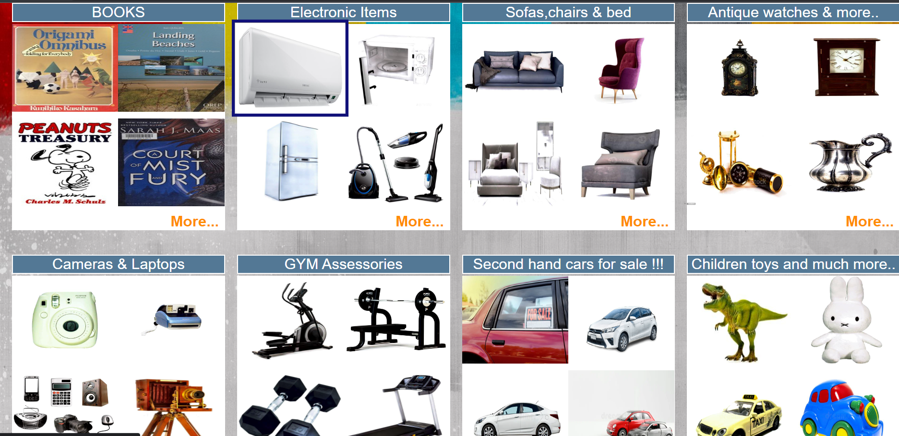
CATEGORIES SECTIONS

Slide 11
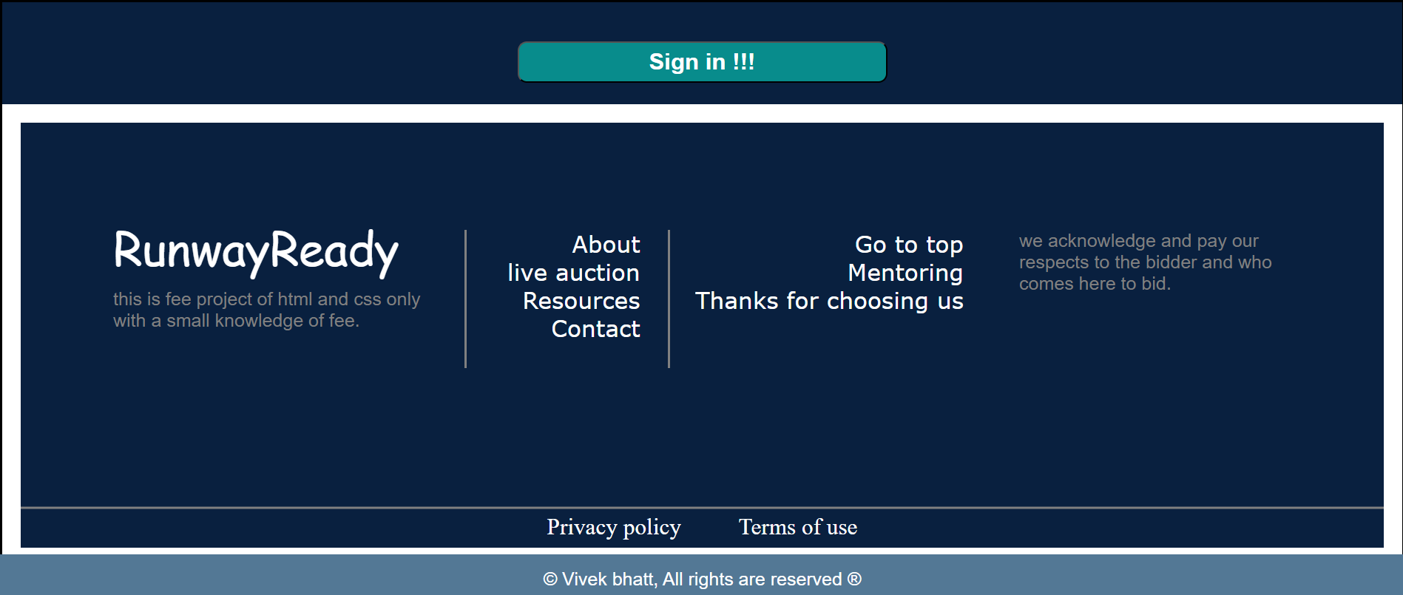
FOOTER SECTION OF THE SITE

Slide 12
Bonus Feature(optional)
1.Implement a countdown timer for auctions to create excitement.
2.Allow users to set auto-bids to automatically bid up to a certain amount.
3.Add a seller rating system based on successfully auctions

Slide 13
Conclusion
Runway Ready is not just an auction platform; it's a vision of simplicity, trust, and style. Developed with HTML, CSS and JavaScript. This platform is a solution to common challenges in the world of buying and selling second-hand items. It offers a user-friendly design, real-time bidding, secure payments, and a range of interactive features that enhance the user experience.

Slide 14
References/Links used
FONT AWESOME-for using icons like search icon, cart icon etc.
CANVA- used to create logo or some images.
PINTREST – used to make site beautiful by using images of pintrest.

Slide 15


